Slide 1

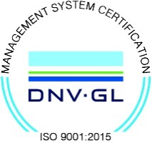
Subject Name : EC8652-Wireless Communication Presentation Title: Cellular Architecture
JEPPIAAR INSTITUTE OF TECHNOLOGY
“Self-Belief | Self Discipline | Self Respect”
Department of Electronics and Communication Engineering
Team Members:
Students Name
1. Jagadisan S
2. Sudakar V
3. Campell S
4. Ajith Kumar M
5. Charmathi K
6. Dharini D
Reg No:
210617106042
210617106076
210617106020
210617106004
210617106021
210617106023

Slide 2
Objective
To Design / Analyze/ Evaluate the performance of
Cellular networks: From 1G to 3G
Overview of Location Services
Frequency Reuse
Characteristic Frequency Change
First-Generation Cellular
Result and Discussion
Future Scope

Slide 3
History of Mobile Generation Technologies
1G: First generation wireless cellular: Early 1980s
Analog transmission, primarily speech: AMPS (Advanced Mobile Phone Systems) and others
2G: Second generation wireless cellular: Late 1980s
Digital transmission
Primarily speech and low bit-rate data (9.6 Kbps)
High-tier: GSM, IS-95 (CDMA), etc.
Low-tier (PCS): Low-cost, low-power, low-mobility e.g. PACS
2.5G: 2G evolved to medium rate (< 100kbps) data
3G: future Broadband multimedia
144 kbps - 384 kbps for high-mobility, high coverage
2 Mbps for low-mobility and low coverage
Beyond 3G: research in 4G

Slide 4
Block Diagram
Cell 1
Mobile
Telephone
Switching
Center
(MTSC)
Public
Switched
Telephone
Network
(PSTN)
Cell 2
HLR
VLR
Location Services
Mobile User
Base Transceiver Station (BTS)
Cordless connection
HLR = Home Location Register
VLR = Visitor Location Register
Wired connection

Slide 5
Technical Details
Location services
Cell-id based location.
assigned an id of the cell that you are in.
cell-id is stored in a database.
As you move from one cell to another, you are assigned a different cell-id and the location database is updated.
most commonly used in cellular networks. (HLR, VLR)
Neighborhood polling: Connected mobile units only move to adjacent cells
Angle of arrival (AOA). the angle at which radio waves from your device "attack" an antenna is used to calculate the location of the device.
Time taken. In this case, the time taken between the device and the antenna is used to calculate the location of the device.
Network assisted Global Positioning System (GPS). a GPS chip is installed inside a phone and thus the location of the user is tracked.

Slide 6
Frequency Reuse
The concept of frequency reuse is based on assigning to each cell a group of radio channels used within a small geographic area
Cells are assigned a group of channels that is completely different from neighbouring cells
The coverage area of cells is called the footprint and is limited by a boundary so that the same group of channels can be used in cells that are far enough apart

Slide 7
Major Mobile Radio Standards USA
Standard | Type | Year Intro | Multiple Access | Frequency Band (MHz) | Modulation | Channel BW (KHz)
AMPS | Cellular | 1983 | FDMA | 824-894 | FM | 30
USDC | Cellular | 1991 | TDMA | 824-894 | DQPSK | 30
CDPD | Cellular | 1993 | FH/Packet | 824-894 | GMSK | 30
IS-95 | Cellular/PCS | 1993 | CDMA | 824-894 1800-2000 | QPSK/BPSK | 1250
FLEX | Paging | 1993 | Simplex | Several | 4-FSK | 15
DCS-1900 (GSM) | PCS | 1994 | TDMA | 1850-1990 | GMSK | 200
PACS | Cordless/PCS | 1994 | TDMA/FDMA | 1850-1990 | DQPSK | 300

Slide 8
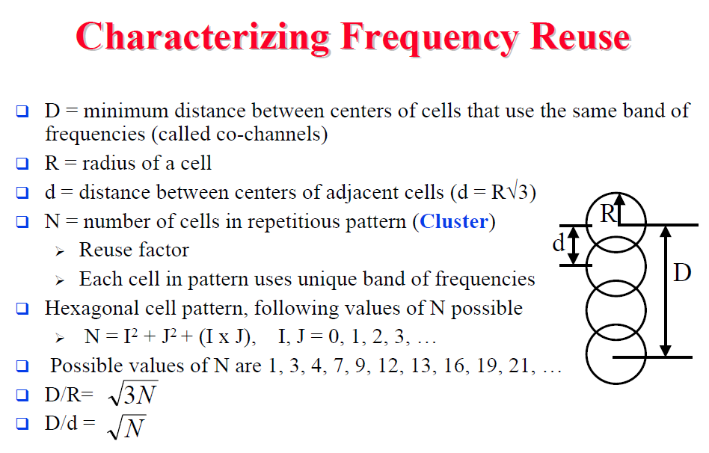
Characteristic Frequency Change

Slide 9
First-Generation Cellular
Advanced Mobile Phone Service (AMPS) invented at Bell Labs and first installed in 1982
Used in England (called TACS) and Japan (called MCS-L1)
Key ideas:
-- Exclusively analog
Geographical area divided into cells (typically 10-25km)
Cells are small: Frequency reuse exploited in nearby (not adjacent) cells
As compared to IMTS, could use 5 to 10 times more users in same area by using frequency re-use (divide area into cells)
Smaller cells also required less powerful, cheaper, smaller devices

Slide 10
As a result Cellular Architecture provides testing and the estimation of the cellular network. It can be widely discussed under the effective measure control field and broadband communication.
It will also provides certain benefits like:
Adding/reassigning channels - some channels are not used
Frequency borrowing – frequencies are taken from adjacent cells by congested cells
Cell splitting – cells in areas of high usage can be split into smaller cells
Microcells – antennas move to buildings, hills, and lamp posts

Slide 11
Future Scope
Protocols above the link layer of the GSM signaling protocol architecture provide futuristic scopes like:
Radio resource management: controls setup, termination and handoffs of radio channels
Mobility management: location and security (MTSO)
Connection management: connects end users
Mobile application part (MAP): between HLR,VLR
BTS management: management base system

Slide 12
Reference
S. Majumder , T. Mondal , and M. J. Deen , “Wearable sensors for remote health monitoring,” Sensors, vol. 17, no. 1, p. 130, 2017.
C. Garripoli , M. Mercuri , P. Karsmakers , P. J. Soh , G. Crupi , G. A. E. Vandenbosch , C. Pace, P. Leroux , and D. Schreurs , “Embedded DSP based telehealth radar system for remote in-door fall detection,” IEEE Journal of Biomedical and Health Informatics, vol. 19, no. 1, pp. 92– 101, Jan 2015.
R. Nakamura and H. Hadama , “Target localization using multi-static UWB sensor for indoor monitoring system,” in 2017 IEEE Topical Conference on Wireless Sensors and Sensor Networks (WiSNet) , pp. 37–40, Phoenix, AZ, USA, January 2017.
V. K. Singh, S. Dhupkariya , N. Bangari , “Wearable ultra wide dual band flexible textile antenna for WiMax /WLAN application” Int. J. Wirel . Pers. Commun . 95(2), 1075–1086 (2017)

